Slide 1
Pierre Bourdieu
Cultural Reproduction Theory
Uses the concept of culture to explain the role of schools in reproducing inequality in society
Social classes have distinct cultures (the idea that economic experiences create certain worldviews)
How do schools exercise power ? By mirroring the culture of the dominant class - promoting the values, beliefs, attitudes and preferences of the dominant (i.e., high status) groups in society.
“Capital” metaphor illustrates how schools privilege middle/upper class culture and devalue the cultures of working class and poor groups.

Slide 2
Cultural & Social Capital in Schools
Dominant cultural capital is the basis upon which the reward system in schools is built.
Achievement and performance in school are tied to dominant cultural capital:
It’s all about what you know (based on ideas about what counts as knowledge), how you demonstrate what you know, and who you know

Slide 3
Anyon , Social Class and the Hidden Curriculum of Work
Social Class | Typical Parent Occu. | Schoolwork | Teacher Rewards
Working class | Stockroom worker, storeroom worker, auto mechanics, gas station attendants, security guard | Following steps for a mechanical procedure, involving rote behavior, little student choice; teachers rarely explain | Following the correct steps and not necessarily doing the work correctly
Middle class | Blue-collar “rich,” carpenters, construction workers, office jobs, city employees, accountants | Getting the right answer to get a good grade; following directions leads to right answers but so does student decision-making | Getting the right answer which is found in books or by listening to the teacher
Affluent professional | Cardiologist, corporate lawyer, engineer, advertising executive | Working independently, creatively to express ideas, concepts | Quality of individual expression, appropriateness to the task
Executive elite | Top executives in multi-national corporations | Developing analytic skills and intellect to solve complex problems | Quality of thinking; high level intellectual ideas

Slide 4
Cultural Capital is Context-Specific P. Carter article
If I’m talking to my friend or father, like “Yo, whasup, whatever?” And when I call my job, I have a different attitude towards the whole situation, you know. I don’t talk with slang. I make sure everything is correct. But I don’t know. Personally, I think . . . for a black person to “act white” . . . like when he arrives [at home] I think he don’t have to do that. But like even if he’s in school, he can act like that in school. Maybe it’ll get him somewhere. You know? And when he goes out . . . I don’t know . . . don’t have to act like that. You can just be yourself. But there is going to be times in your life where you are going to have to put on a little act, or a little show to get the extra budge or what- ever, you know.

Slide 5
Recognizing Cultural Capital Teachers Value (P. Carter article)
Like I say, I mean . . . the way you present yourself to someone, that’s the approach that they take upon you. And some Black kids, you know, when they go to school, the first thing the teacher looks at is how you present yourself. So you come to school with the baggy pants and hat to the back, with the radio, they look at you and be like, “I’m not going to waste my time.” But they see the other, like you know, not the whole [person] White or Black, but when they see another fellow, or male or female you know, quiet, and then that’s the one they’ll spend more time with. But not knowing that person that came with the baggy pants, could be more intelligent, you know, have more intellectuals [sic] than a quiet person.

Slide 6
Social Capital (Stanton-Salazar & Dornbusch reading)
The role of institutional agents – individuals who have the power to “transmit directly or to negotiate the transmission of institutional resources and opportunities.”
Specifically, the relationship between the educational and occupational goals of Mexican-origin high school students, their academic achievement and ties with institutional agents.
Middle/upper class students typically acquire social capital through their families and their families’ networks (contacts for college admissions coaching, private tutoring, internships, prestigious academic programs, etc.)

Slide 7
Social Capital (Stanton-Salazar & Dornbusch reading)
Effective development of relationships with institutional agents depends on how well students’ “social consciousness” (personality, behavior, habits) matches the institutional culture of the school.
Prior research on students’ post-high school aspirations focus largely on the family
Authors maintain that minority students, including low-income whites, often need school personnel to provide the necessary information and resources (social capital)

Slide 8
Social Capital (Stanton-Salazar & Dornbusch reading)
Hypothesis 1 – predicts that students acquire social capital depending on their class background
All students’ social capital through institutional agents increased, but middle/upper income Latino students had a greater advantage because their parents were counted.
Looking at language attributes for this group, the effect of class background was eliminated or reduced. The use of Spanish negatively affected friendships with non-Mexican origin peers

Slide 9
Social Capital (Stanton-Salazar & Dornbusch reading)
Hypothesis 2 – accumulating social capital is positively related to the students’ English language proficiency
Proficiency in English is a proxy for dominant cultural capital.
Access to school personnel significantly increased when students were proficient in English
Surprise finding: bilingualism was positively associated, which could mean that school personnel view bilingualism as important cultural capital

Slide 10
Social Capital (Stanton-Salazar & Dornbusch reading)
Hypothesis 3 – students with higher grades have greater access to social capital
No consistent effect which could be a problem with the study design, however
Hypothesis 4 – students with higher status expectations for themselves as adults have greater access to social capital
Mixed results, nothing conclusive. However, it’s possible that status expectations plus grades may influence access to institutional social capital for low-income and high-income Latino students who are English proficient.

Slide 11
Social Capital (Stanton-Salazar & Dornbusch reading)
Revised hypotheses based on mixed results and surprise findings of the effect of bilingualism:
Working class minority students with high grades and status expectations who are acculturated, acquire social capital from institutional agents.
“Our findings suggest that the lower SES Spanish-dominant students in our sample have yet to acculturate sufficiently. Because of language and cultural barriers, many immigrants are denied opportunities to acquire valued institutional support – even when their consciousness and their efforts may reflect and pay tribute to American ideals of hard work and material success.”

Slide 12
High school college advising in San Diego
Research part of a larger study of low-income youth and their options and choices after high school up until their mid-twenties.
San Diego - studied how low-income students interpreted their options and made decisions about postsecondary education and employment at six high schools (4 in low-income neighborhoods, 2 in middle and high income neighborhoods)
Three waves of 60- to 90-minute interviews with 100 students, beginning in either their junior or senior year. We also conducted interviews with administrators, teachers, and counselors, and gathered participant demographic and educational background information through surveys and school- and district-level data sources.
Notes:
My 2013 research on SD high school students’ transition from secondary to postsecondary

Slide 13
Key themes about college advising
Students need more and better information about college.
Students need more and better interactions with counselors around college advising.

Slide 14
Students need more and better information about college
Students reported that they learned about UC/CSU college eligibility requirements, college application procedures, community college information, SAT/ACT test-taking, and financial aid, but it was clear that they often had insufficient information to make sound decisions.
For instance, students often cited the UC system’s “A–G” course requirements as part of college eligibility, but they were not always certain that the courses they were taking in high school would meet these requirements. In many cases, students did not have enough information to even know what questions to ask, or had incorrect information that could easily lead them in the wrong direction.

Slide 15
Students need more and better information about college
One student explained that she relied on her counselor as the primary source of information, but she had to begin the conversation herself. When asked how she might find out more information, she explained, “Honestly I don’t really know. I would love to learn more, it’s just no one [at the high school] really provides that information. And then, like, I don’t really know what to ask.”
Another student, who attended information sessions alone and with her parents, noted that she “would learn and try to understand everything, but it is like something is missing from what they are trying to explain or teach. Or there’s something that I didn’t understand.”

Slide 16
Students believe the wrong information
One student believed that failure to pass the California High School Exit Examination barred individuals from enrolling in community college. She described one friend who “just decided to give up, which a lot of kids do. They just give up because they think they’re never going to pass [the CAHSEE]. Then they ask why people aren’t going to college, and [not passing] is holding them back from going to college.”
Another student believed that beginning at a two-year college meant those years would be tacked on to a four-year degree, for a total of six years of college.

Slide 17
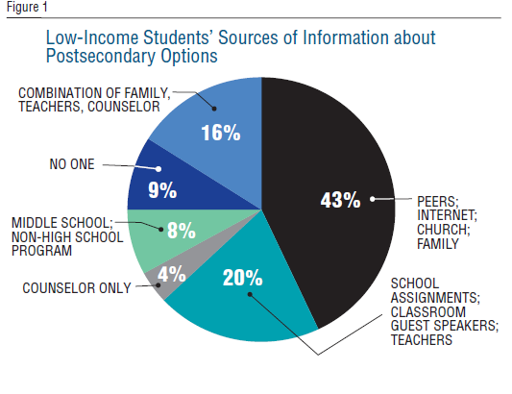
Students need more and better interactions with counselors around college advising

Slide 18
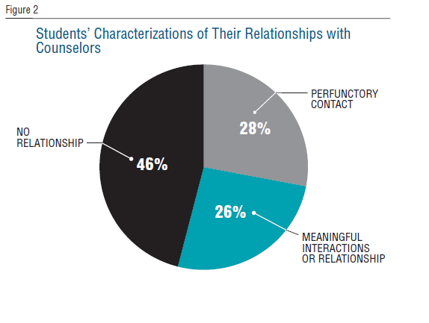
Students need more and better interactions with counselors around college advising

Slide 19
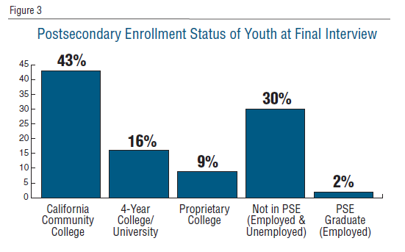
Weak counseling impacted postsecondary outcomes

Slide 20
Weak counseling impacted postsecondary outcomes
Youth who had enrolled in two-year and four-year colleges managed to do so with little help from their high school counselors.
Of the nine students (16%) who enrolled in four-year colleges immediately after high school, only one student said he had a meaningful relationship with his counselor. Participation in out-of-school college support programs was common among these students, as were college-enrolled siblings and friends who provided accurate advice.

Slide 21
Weak counseling impacted postsecondary outcomes
Youth who enrolled in two-year and four-year colleges managed to do so with little help from their high school counselors.
Of the 43% who enrolled in community colleges, only about one third said they had meaningful relationships with their counselors. Some of these students might have been eligible to attend four-year colleges directly out of high school if they had experienced deeper counselor relationships before graduation.
Most disappointing are the 30% of students who had not enrolled in any PSE institution by the end of the study. Of these 17 students, a mere four said they had meaningful relationships with their counselors.

